Slide 1
Deep Learning By MXK
Notes:
But before we do that, it's going to be helpful to dive into a bit of theory to
understand how computer vision works. Don't worry though: there will be very
little math, and understanding a bit about how computer vision works will help
us understand what can go wrong, and how to fix it.

Slide 2
Summary 1- Machine Learning Roadmap 2- Deep Learning Roadmap 3- Convolutional Neural Network 4- Recurrent Neural Network 5- Long Short Term Memory 6- Closing Thoughts

Slide 3
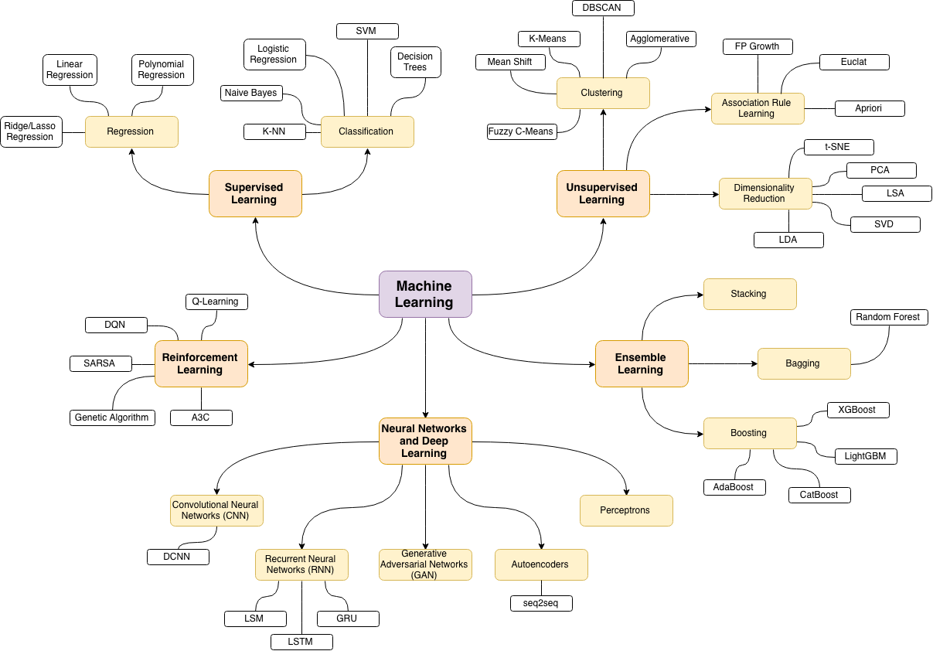
Notes:
Raodmap

Slide 4
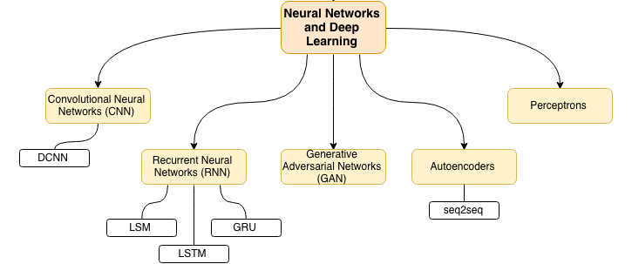

Slide 5
Convolutional Neural Network
dog
bicycle
apple
tennis ball
Notes:
You've probably heard that AI is powered by something called "Deep Learning". The "Deep" in "Deep Learning" doesn't mean "profound", it simply means that the image passes through a neural network with many layers when it's being analyzed. That's it.
On your screen is a very simple Neural Network. This one only has five layers; real-world vision systems have many dozens of layers, perhaps hundreds. This one is designed to take an image as input, and then classify that image as one of exactly four objects: dog, bicycle, apple, and tennis ball. That's it: it is not capable of detecting any other kind of object except those it's been trained to recognize.

Slide 6

Trained Convolutional NN
dog
0.02
02
bicycle
0.93
apple
0.27
tennis ball
0.21
Notes:
When a Neural Network has been trained, it passes the input image through the network layer by layer, at each layer transforming the image into different, smaller images. Each layer recombines the images genrated in the prior layer, and the images get smaller and smaller until at the very end they are just a single pixel with a value between 0 and 1. That value represents the confidence the Neural Network has that the image represents the given object: they higher the number, the more confident it is.
In this case, we've inputted an image of a bicycle and the "bicycle" node at the right side is the one with the highest value. So it looks like this neural network has been well-trained to detect bicycles (or at least this one). But how do you "train" a neural network, and how is the image being transformed along the way?
At each node of the network -- each circle -- a filter is applied to the image. It's much the same idea as a Snapshot filter or an Instagram filter, but instead of doing something useful like making the image sepia toned or adding bunny ears to all the faces, it's doing something ... different ... that was decided in the training process. Let's dive in to see what that is.

Slide 7

Pre-Trained Convolutional NN
dog
0.00
02
bicycle
0.96
apple
0.11
tennis ball
0.18
Notes:
So, you can just use the model with the pre-determined weights, and as long as you only need to detect the object classifications the model is trained for, you're all set to go. Just provide your image, and use the classifications that the pre-trained model generates.
Some models do more than just classify, too: they can also detect the location of objects within images, or analyze the image in other ways.

Slide 8
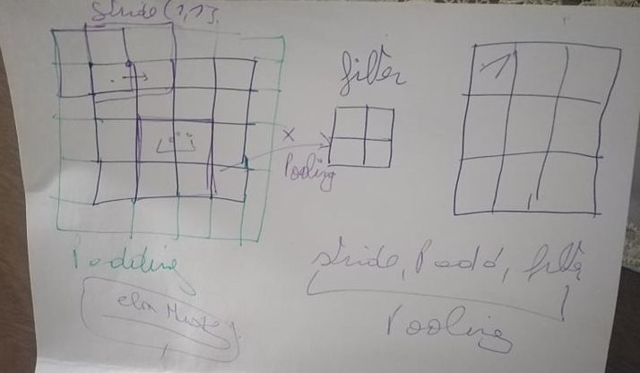

Slide 10
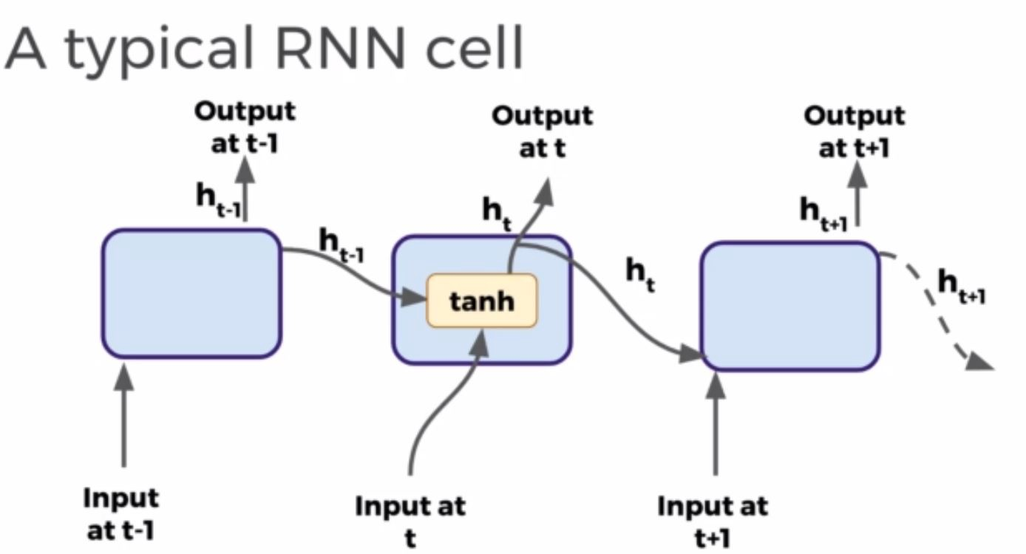

Slide 11
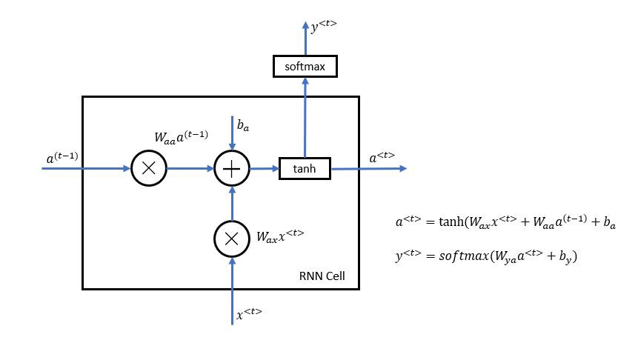

Slide 12
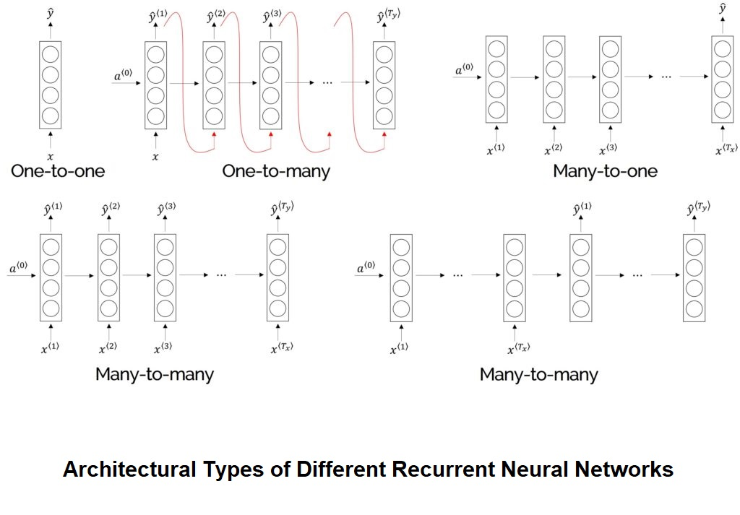
Notes:
Many-to-Many [1]
Since there are multiple inputs which result in multiple outputs we can call it a Many-to-Many architecture.
The input and the output sequence lengths are equal.
Many-to-Many [2]
There are examples where these input and output lengths are different. Machine Translation is one such real-life case where the input sentence says, in French, and the output sentence is a translated English one, which may have a different number of words than the original sentence but of course, the meaning remains the same.
Many-to-One
We will take the case of Sentiment Classification to explain this category of RNN models where there are multiple inputs but only one output value.
One-to-Many
A single input that results in multiple output values or an output sequence. This particular architecture can be found in the Music Generation problems.
Only the activation values that predict outputs at each time step and multiple outputs predicted are received until the last note of the musical piece is synthesized.

Slide 13
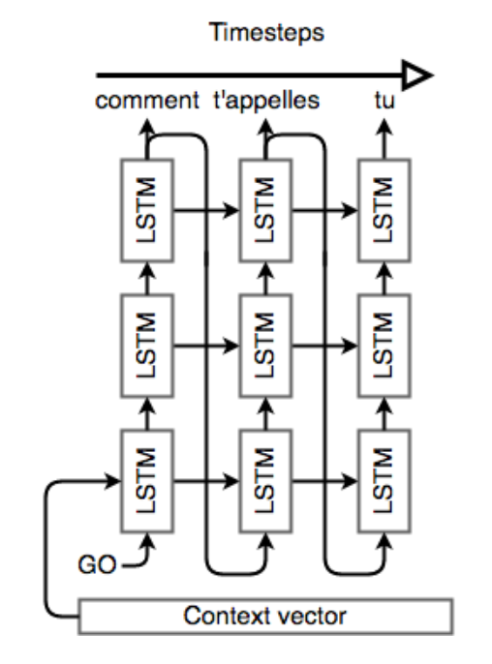
Notes:
Long short-term memory is an artificial recurrent neural network architecture used in the field of deep learning. Unlike standard feedforward neural networks, LSTM has feedback connections. It can not only process single data points, but also entire sequences of data.

Slide 14
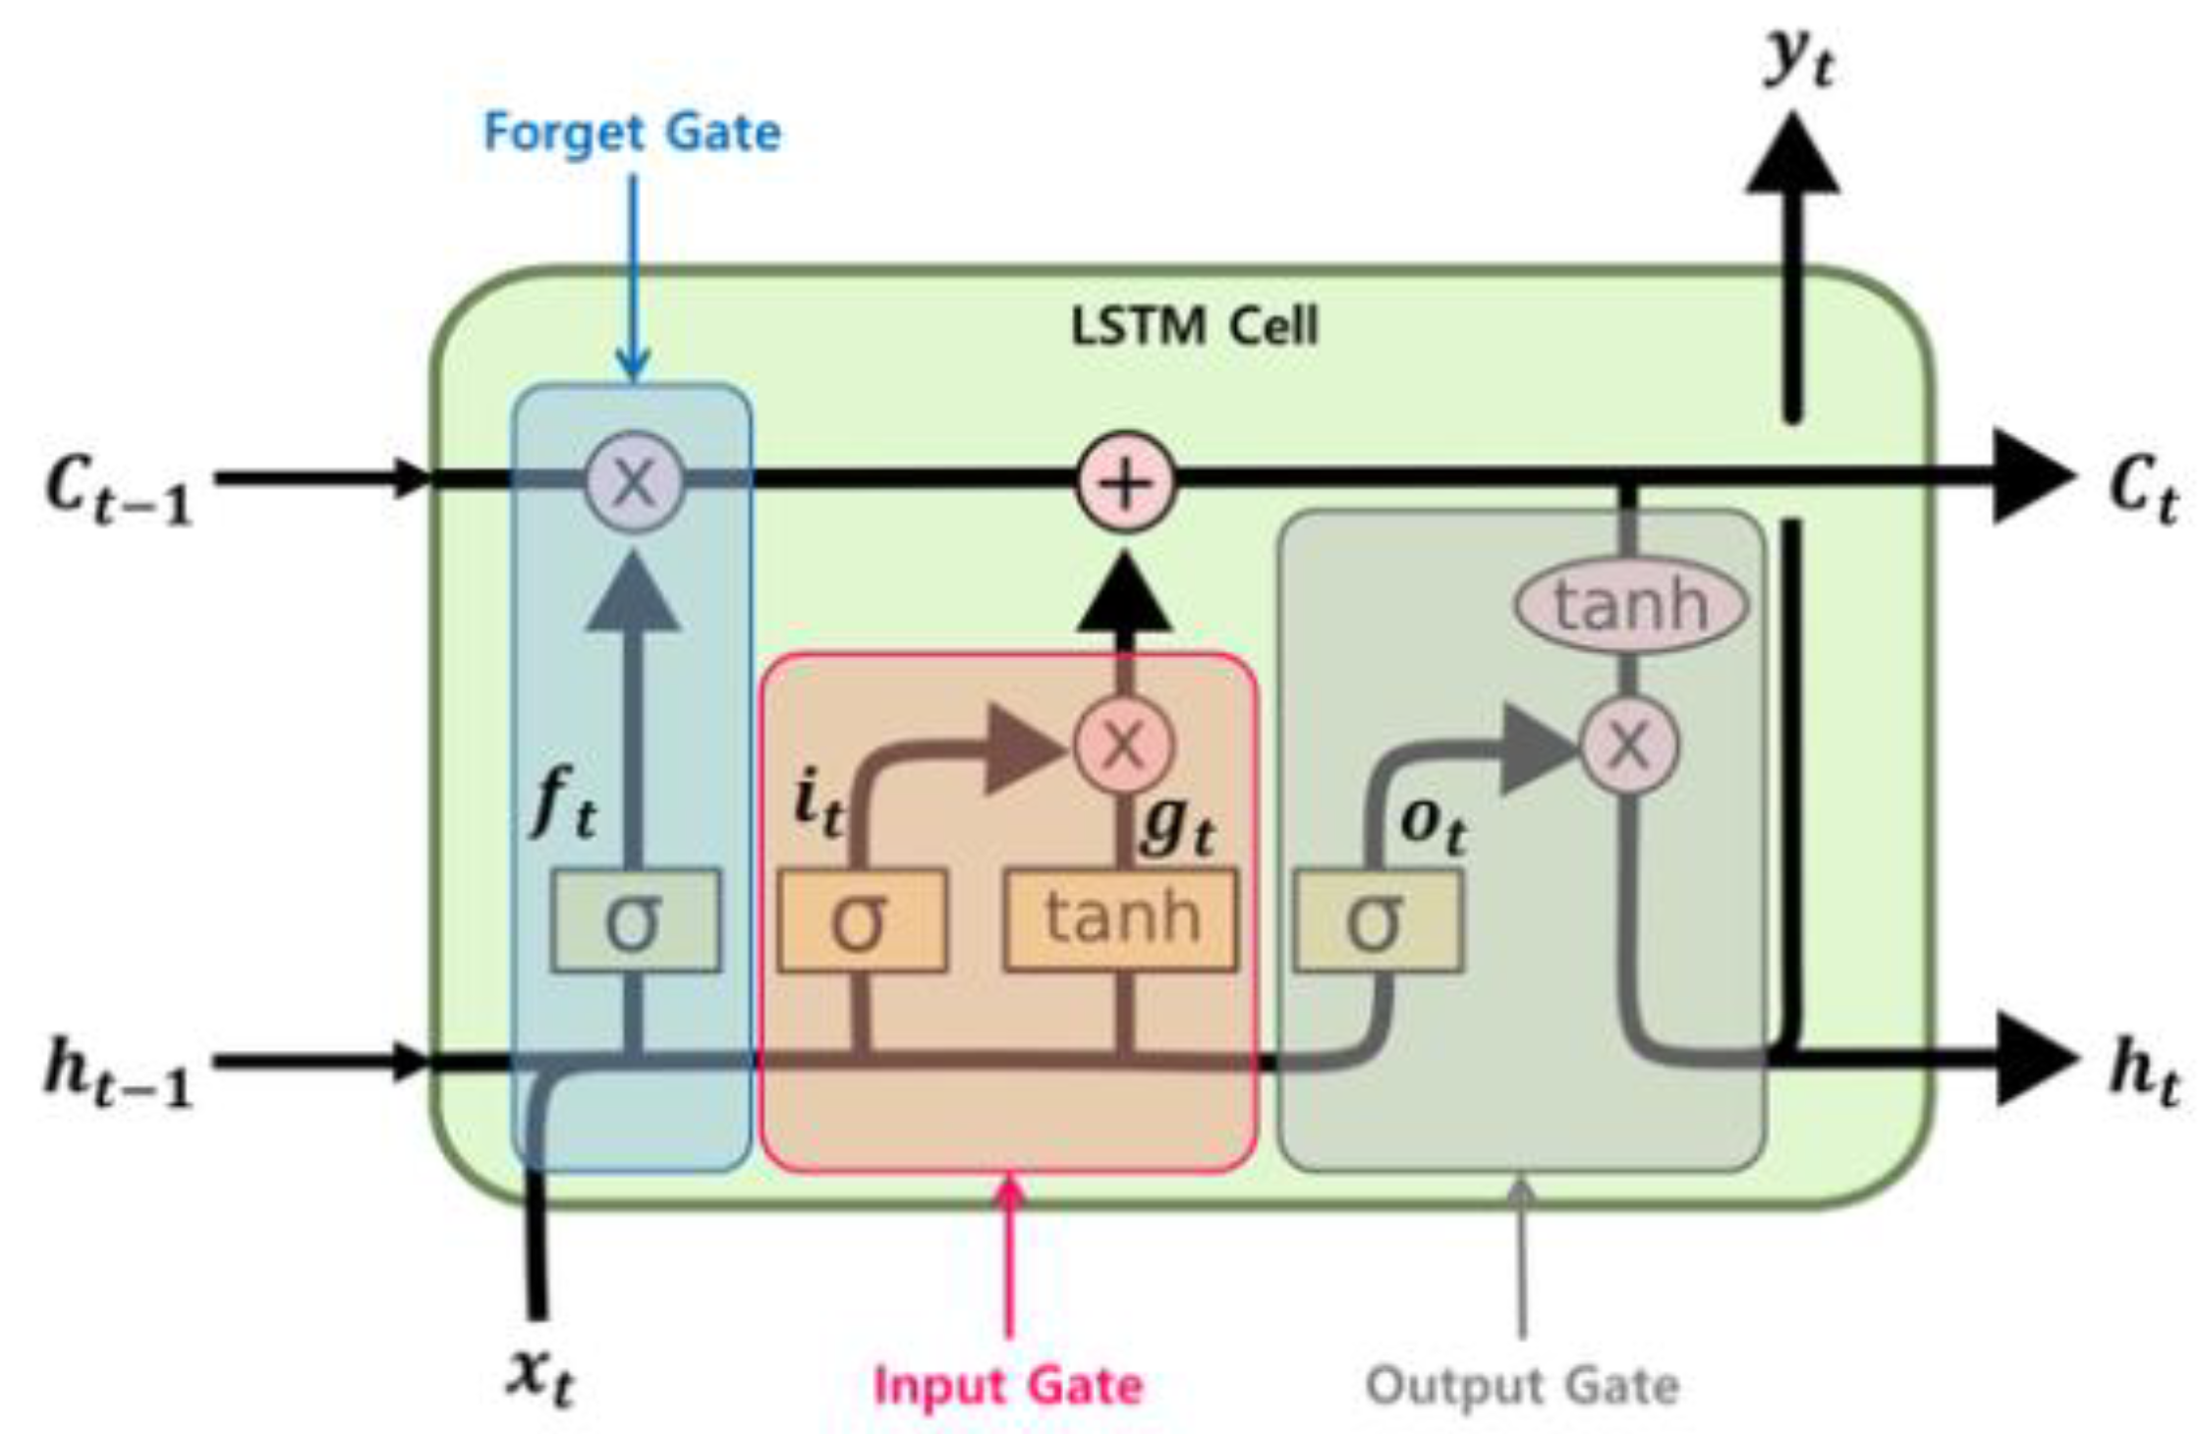

Slide 15
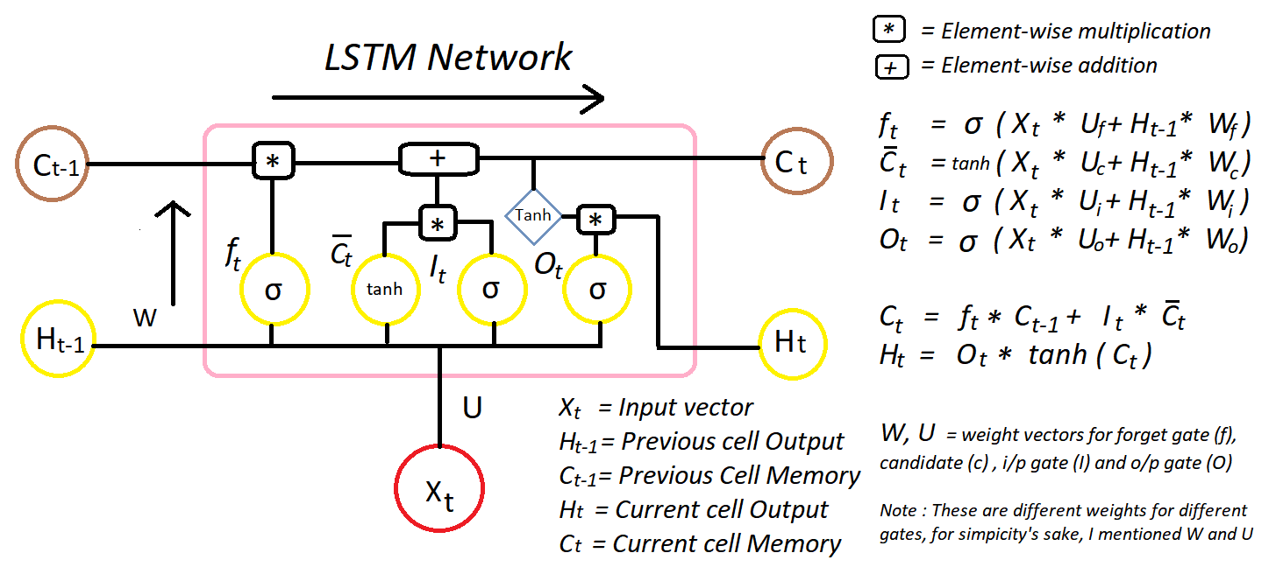

Slide 16
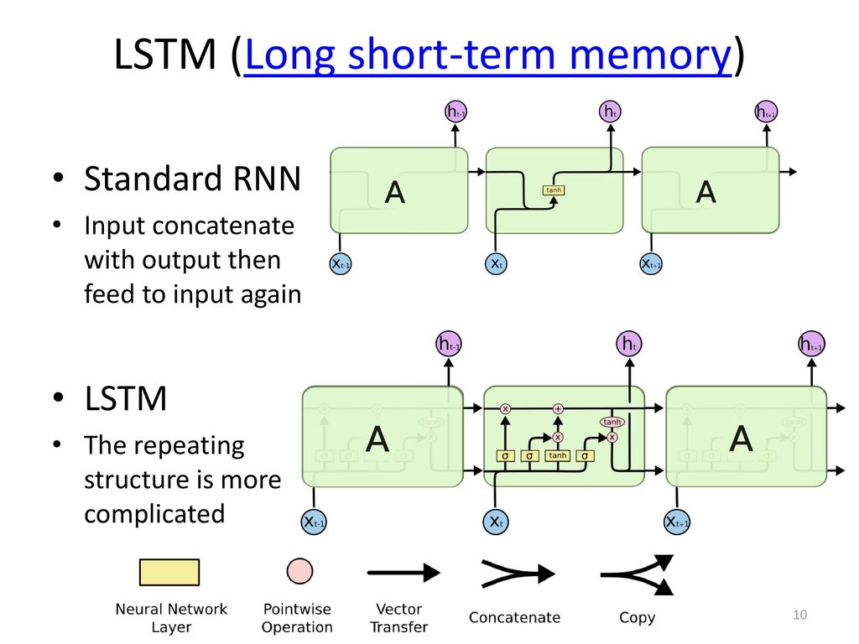

Slide 17
Thank you!
Q & A

